Slide 1
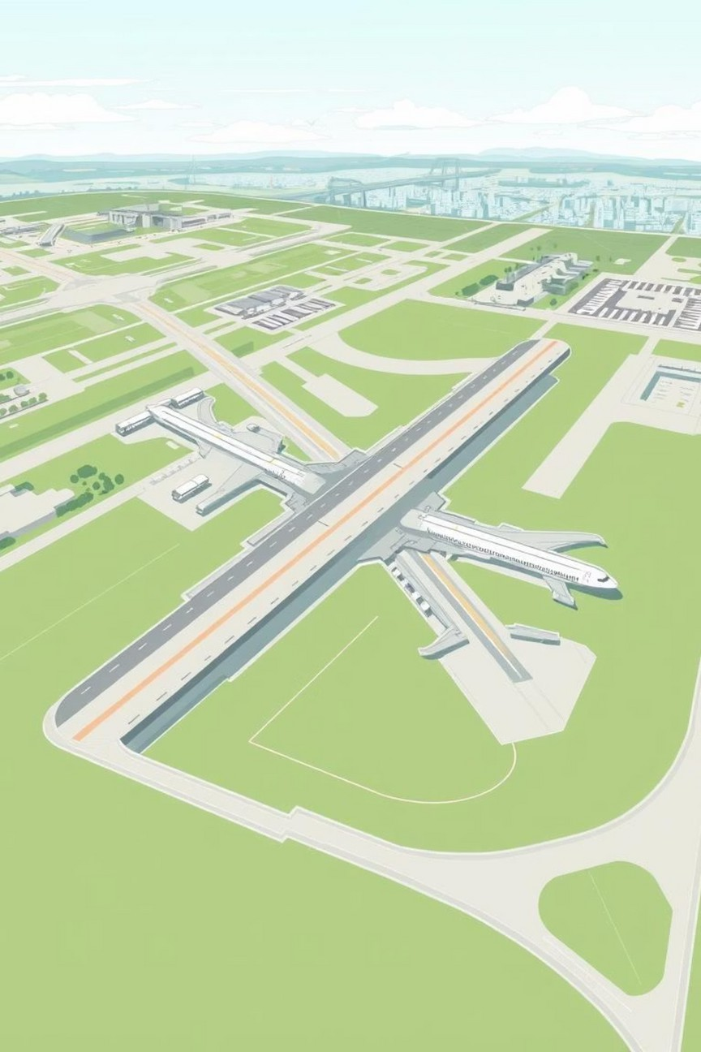

Navi Mumbai International Airport (NMIA)
Streamlined Environmental Impact Assessment
Team Members:
BENNAT SANIL BIYA BIJI
CHRISTIN JOSE BIJU DHANUSH RAJESH DIYA SHELLY
DONI BELGI ELDHOSE GEORGE

Slide 2
Introduction & Project Significance
The Navi Mumbai International Airport (NMIA) is a greenfield international airport being developed in Ulwe, Panvel Taluka, to cater to the growing air travel demand of the Mumbai Metropolitan Region (MMR).
Key Objectives & Capacity
Capacity: Designed to handle a minimum of 60 million passengers per annum (MPPA) and 1.5 million tonnes of cargo annually at its final phase.
Vision: To be a climate-resilient, carbon-neutral airport with a state-of-the-art IATA benchmark level of service.
Why is NMIA Critical?
Growing Demand: MMR's annual air passenger traffic is projected to exceed 160 million by 2038, a demand the existing Chhatrapati Shivaji Maharaj International Airport (CSMIA) cannot handle alone as it is nearing its operational limit.
Economic Hub: The project is crucial for maintaining Maharashtra's economic leadership and cementing Mumbai's future as an International Financial Centre.
Dual Airport System: NMIA will create India's first dual international airport system for a single metropolitan region, relieving pressure on the land-constrained CSMIA.

Slide 3
Project Proponent & Current Status
Project Execution
Proponent: Navi Mumbai International Airport Pvt. Ltd. (NMIAL), a Special Purpose Vehicle (SPV).
Ownership: A Public-Private Partnership (PPP) with Mumbai International Airport Ltd. (MIAL) holding a 74% stake and the City and Industrial Development Corporation (CIDCO) holding 26%.
Model: The project is being implemented on a Design, Build, Finance, Operate, and Transfer (DBFOT) basis.
Project Status (as of mid-2021)
On-going Project: On-site work commenced in April 2017.
Pre-Development Works: Major activities like the cutting of Ulwe Hill and the diversion of the Ulwe River are nearly complete. Financial Progress: A total of ₹5,478 Crores has been incurred till March 2021, which is 35% of the Phase-I project cost.
Rehabilitation & Resettlement (R&R): 97.3% of the 3,113 project-affected families have been successfully rehabilitated.

Slide 4
Phase Development Plan
The airport will be developed in four distinct phases to gradually scale capacity with rising traffic demand. Phase I is scheduled for completion by December 2024.
Phase
Terminal Development
Cumulative Capacity
Phase I
Terminal 1 (with West Pier)
10 MPPA
Phase II
Terminal 1 (with West & East Pier)
20 MPPA
Phase III
Terminal 2
40 MPPA
Phase IV
Terminal 3
60 MPPA
Subsequent phases (III and IV) will be initiated based on traffic triggers, ensuring infrastructure development stays ahead of demand.

Slide 5
Airport Master Plan: Airside Infrastructure
The airside is designed for maximum operational efficiency and safety, accommodating the largest modern aircraft.
Runways
Two parallel Code 4F runways, each 3,700m long and 60m wide, separated by 1,580m to allow for simultaneous and independent operations.
Taxiways
An efficient, dual, full-length parallel taxiway system with Rapid Exit Taxiways (RETs) to minimize runway occupancy time.
Aprons
A mix of contact stands (with aerobridges) and remote stands to accommodate various aircraft sizes (Code C, E, and F).
Air Traffic Control (ATC)
An interim ATC tower will be used for early phases, followed by a final 104- meter high tower in Phase III to provide unimpeded airfield views.
Navigational Aids (CNS)
State-of-the-art systems including ILS, DVOR/DME, and Advanced Surface Movement Guidance Systems for safe, all-weather, 24/7 operations.

Slide 6
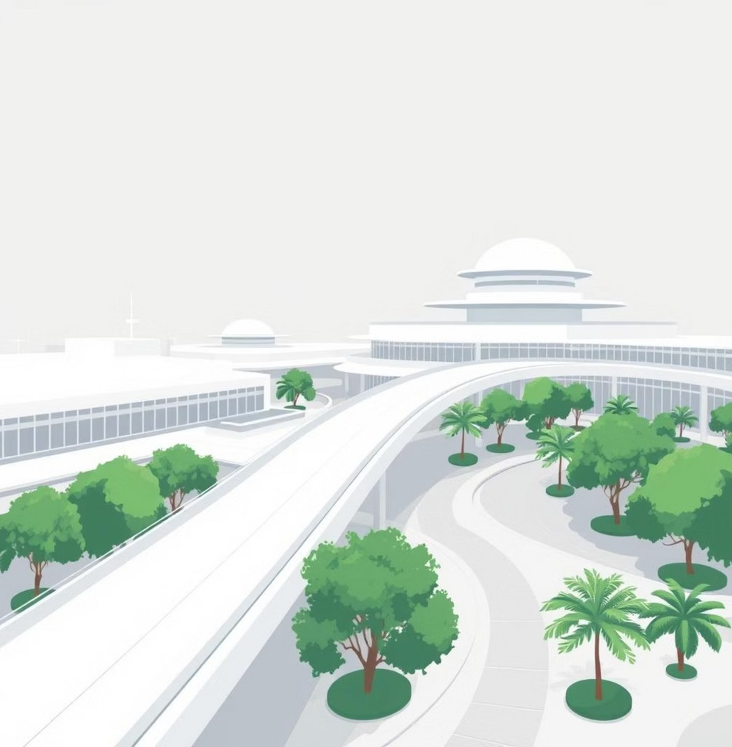
Airport Master Plan: Landside Infrastructure
The landside is planned as a multi-modal hub, seamlessly integrating the airport with the surrounding region.
Central Terminal Complex (CTC)
Three interconnected passenger terminals (T1, T2, T3) will form a central hub, designed by Zaha Hadid Architects.
Access & Connectivity
Main access is planned from Amra Marg (west) and NH-4B (east). The airport will have direct connectivity with the Mumbai Trans-Harbour Link (MTHL) and a proposed Metro line, making it highly accessible.

Slide 7
Environmental Setting & Baseline Status
A comprehensive baseline study was conducted from December 2019 to February 2020 within a 10 km radius to assess the existing environmental conditions.
Key Environmental Sensitivities:
Karnala Bird Sanctuary & ESZ: 2.5 km South-East. Matheran Eco-Sensitive Zone: 9.3 km East-North-East. Thane Creek Flamingo Sanctuary ESZ: 9.2 km North-West.
Aquatic Features: The site is adjacent to Panvel Creek and Gadhi River, with surrounding mangroves and mudflats.
Baseline Findings:
Air Quality: All monitored parameters (PM₁₀, PM₂.₅, SO₂, NO₂) were found to be within the National Ambient Air Quality Standards (NAAQS).
Noise Levels: Generally within permissible limits for commercial and industrial areas. Some residential zones showed higher levels, primarily due to existing road traffic.
Water Quality: Surface water bodies are classified as 'Class C' (not suitable for drinking). However, groundwater quality is good and meets IS:10500 standards for potable water.

Slide 8
Key Environmental Impacts: Development Phase
The development phase involves significant, though largely temporary, environmental impacts.
Land Use & Topography
Irreversible change from a natural landscape with hills, a river, and villages to a reclaimed, flattened airport site. The land use has been officially changed to "International Airport & Allied Activities".
Air Quality
Temporary increase in dust and particulate matter from earthworks, vehicle movement, and operation of crushers and concrete plants.
Noise & Vibration
Increased noise levels due to heavy machinery operation and controlled blasting activities.
Water Quality
Potential for increased sediment load and turbidity in nearby water bodies from surface runoff.
Ecology
Habitat Loss: Complete removal of on-site terrestrial and aquatic ecosystems. This included clearing 108.6 ha of mangroves and felling/transplanting thousands of trees.
Socio-Economic
Physical displacement of 3,113 households from 8 villages located within the project site.
River Diversion: The natural course of the Ulwe River was diverted into a new man-made channel (Ulwe Recourse Channel).

Slide 9
Mitigation Measures: Development Phase
Robust mitigation strategies have been implemented to offset the impacts of construction.
Air & Noise
Strict dust suppression measures like regular water sprinkling and wet drilling.
All vehicles and equipment are required to have valid pollution control certificates and proper mufflers. Controlled blasting is limited to daytime hours with advanced safety protocols.
Ecological Compensation
Mangrove Afforestation: Compensatory plantation of mangroves has been completed over 499 ha (109 ha at Kolekhar + 390 ha by FDCM) to offset the 108.6 ha cleared. Compensatory Afforestation: 670,073 trees have been planted on 250 ha of degraded forest land to compensate for forest land diversion.
Rehabilitation & Resettlement (R&R)
A comprehensive R&R package was provided, exceeding the requirements of the RFCTLARR Act, 2013.
PAPs received developed plots in new R&R pockets (e.g., Pushpak Nagar), monetary compensation for construction and shifting, and skill development opportunities. New community facilities like schools, health centers, and temples have been constructed in the resettlement sites.

Slide 10
Impacts & Mitigation: Operation Phase
The operational phase focuses on managing long-term impacts from airport activities.
Impact Sources
Mitigation Measures
Causes
Aircraft Landing and Take-Off (LTO) cycles, Ground Support Equipment (GSE), vehicular traffic.
Installation of Continuous Ambient Air Quality Monitoring Stations (CAAQMS). Promotion of electric GSEs and green aircraft operations.
Air Pollution
Aircraft take-off, landing, and taxiing, especially affecting funnel zones.
An Integrated Noise Monitoring System (NMS) will be installed. Implementation of noise abatement procedures like Continuous Descent/Climb Operations (CDA/CCO) and restricted use of reverse thrust.
Noise Pollution
Sewage generation (up to 13.3 MLD) and Solid Waste (up to 72 TPD).
On-site STPs (14.25 MLD total capacity) with a Zero Liquid Discharge policy; 100% of treated water will be recycled for flushing, cooling, and irrigation. An integrated solid waste facility with a bio-gas plant will process organic waste.
Water And Waste
Proximity to wetlands, mudflats, and Karnala Bird Sanctuary increases the risk of bird strikes.
A 10-year MoU with the Bombay Natural History Society (BNHS) for scientific bird management, habitat modification, and continuous monitoring to ensure aviation safety.
Bird Hazard

Slide 11
Project Benefit
NMIA is poised to deliver substantial and multi-faceted benefits to the region and the nation.
Economic & Infrastructure Boost
Catalyst for Growth: A major economic engine, boosting industrial development, warehousing, and investment in the MMR.
Enhanced Connectivity: Triggers development of critical transport infrastructure like MTHL, Metro lines, and coastal roads.
Planned Urbanization: Guides systematic, sustainable development of the Navi Mumbai Airport Influence Area (NAINA).

Slide 12
Employment & Social Development
Job Creation: Expected to generate over 5,000 direct jobs during construction and 90,000 permanent jobs (direct & indirect) during operation.
Skill Development: Joint programs with CIDCO and JNPT to provide aviation and logistics-related skills, enhancing local employability.
Improved Quality of Life: The R&R package provides project-affected families with better housing, amenities, and livelihood opportunities.
Corporate Social Responsibility (CSR): NMIAL is committed to CSR initiatives in education, healthcare, and environmental conservation.

Slide 13
Conclusion & The Way Forward
Conclusion
NMIA is a strategically vital project, essential for Mumbai's future aviation demands and economic growth.
A comprehensive Environmental Impact Assessment led to a robust Environmental Management Plan (EMP) for mitigation.
The project delivers significant socio-economic benefits through compensatory measures, progressive R&R, and sustainable technologies, responsibly managing its environmental footprint.
The Way Forward
Strict EMP Adherence: Rigorous implementation of all mitigation measures throughout development and operation.
Continuous Monitoring: Uninterrupted operation of online air and noise monitoring systems for compliance and proactive management.
Stakeholder Collaboration: Continued partnerships with agencies like BNHS, CIDCO, and MMRDA for bird hazard management and timely infrastructure completion.

Slide 14
THANK YOU

